Slide 1
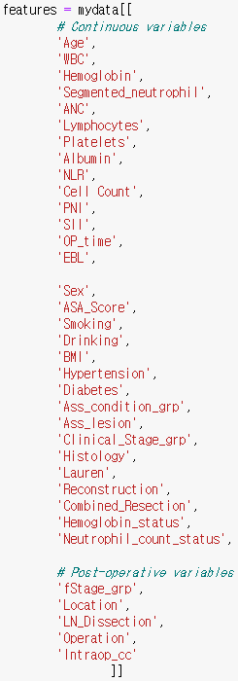






고령 위암 환자 합병증 DL 예측 모형
Multi-class classification Deep-Learning 모형 중 가장 기본적인 Multi-layer perceptron(MLP)을 적용하였음.
Train set: 짝수 년도 수술 받은 환자 (n=1,798)
Test set: 홀수 년도 수술 받은 환자 (n=1,748)
Event of interest: None/Mild complication/Severe complication or death
Input features: Pre-operative variables and/or Post-operative variables
Architecture of Multi-class MLP
Backpropagation to train hidden layers
$$y_{1}$$
Probability that a patient experiences no complication
$$⋮$$
$$⋮$$
$$⋮$$
$$y_{2}$$
Probability that a patient experiences mild complication
$$y_{3}$$
Probability that a patient experiences severe complication or death
Input layer
Hidden layers
Output layer

Slide 2
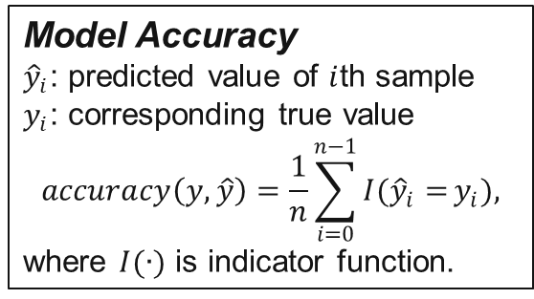
Results from Multi-class MLP
Model Accuracy
${\hat{y}}_{i}$: predicted value of $i$th sample
$y_{i}$: corresponding true value
$$accuracy\left(y, \hat{y}\right)=\frac{1}{n}\sum_{i=0}^{n−1}{I({\hat{y}}_{i}=}y_{i}),$$
where $I(∙)$ is indicator function.
Using pre-operative features only / All age
Train accuracy=0.7843, Test accuracy=0.7752
Mild complication, Severe complication or Death 전부 AUC가 상당히 낮게 나옴.
 |  | Event: Mild
 |  | Train AUC |  |  |  |  |  | Test AUC
 | Hidden Size | 16 | 32 | 64 | 128 | 256 |  | 16 | 32 | 64 | 128 | 256
Number of Layer | 1 | 0.5332 | 0.5446 | 0.5194 | 0.5217 | 0.4911 |  | 0.5456 | 0.4892 | 0.5222 | 0.5219 | 0.4578
 | 2 | 0.4938 | 0.5047 | 0.5000 | 0.4764 | 0.5000 |  | 0.4622 | 0.4661 | 0.5000 | 0.4600 | 0.5000
 | 3 | 0.4860 | 0.5000 | 0.5000 | 0.5000 | 0.5000 |  | 0.4580 | 0.5000 | 0.5000 | 0.5000 | 0.5000
 |  | Event: Severe or Death
 |  | Train AUC |  |  |  |  |  | Test AUC
 | Hidden Size | 16 | 32 | 64 | 128 | 256 |  | 16 | 32 | 64 | 128 | 256
Number of Layer | 1 | 0.4742 | 0.5429 | 0.5042 | 0.5224 | 0.4755 |  | 0.5457 | 0.5610 | 0.5700 | 0.5735 | 0.5256
 | 2 | 0.4762 | 0.4757 | 0.5000 | 0.4861 | 0.5000 |  | 0.5184 | 0.5272 | 0.5000 | 0.5337 | 0.5000
 | 3 | 0.4968 | 0.5000 | 0.5000 | 0.5000 | 0.5000 |  | 0.5193 | 0.5000 | 0.5000 | 0.5000 | 0.5000

Slide 3
Results from Multi-class MLP
Using pre-operative and post-operative features / All age
Train accuracy=0.7843, Test accuracy=0.7752
Compared to pre-operative variables only model, AUC increased little bit but still very low.
 |  | Event: Mild
 |  | Train AUC |  |  |  |  |  | Test AUC
 | Hidden Size | 16 | 32 | 64 | 128 | 256 |  | 16 | 32 | 64 | 128 | 256
Number of Layer | 1 | 0.5425 | 0.5525 | 0.5415 | 0.5452 | 0.5504 |  | 0.6093 | 0.6161 | 0.6067 | 0.6135 | 0.6131
 | 2 | 0.5213 | 0.5370 | 0.5372 | 0.5417 | 0.5090 |  | 0.4919 | 0.5336 | 0.5433 | 0.5402 | 0.5402
 | 3 | 0.5448 | 0.5301 | 0.5248 | 0.5326 | 0.5018 |  | 0.5658 | 0.5503 | 0.5726 | 0.5802 | 0.5324
 |  | Event: Severe or Death
 |  | Train AUC |  |  |  |  |  | Test AUC
 | Hidden Size | 16 | 32 | 64 | 128 | 256 |  | 16 | 32 | 64 | 128 | 256
Number of Layer | 1 | 0.5928 | 0.5955 | 0.5898 | 0.5909 | 0.5965 |  | 0.6089 | 0.6046 | 0.6149 | 0.6034 | 0.6108
 | 2 | 0.5157 | 0.5602 | 0.5902 | 0.5566 | 0.5449 |  | 0.5885 | 0.5922 | 0.5921 | 0.5941 | 0.5860
 | 3 | 0.5650 | 0.5552 | 0.5671 | 0.5732 | 0.5430 |  | 0.6102 | 0.6169 | 0.6260 | 0.6310 | 0.6021

Slide 4
Results from Multi-class MLP
 | n (%)
 | None | Mild | Severe or Death | Total
Train set | 554 (75.9) | 101 (13.8) | 75 (10.3) | 730 (100)
Test set | 503 (74.6) | 100 (14.8) | 71 (10.5) | 674(100)
Using pre- and post-operative features / 65+ Aged
65세 이상 환자 1,404명 중 Train set 52.0%, Test set 48.0%
Train set과 Test set의 complication 분포는 큰 차이 없음
 | Hidden Size | Train Accuracy |  |  |  |  |  | Test Accuracy
 |  | 16 | 32 | 64 | 128 | 256 |  | 16 | 32 | 64 | 128 | 256
Number of Layer | 1 | 0.7575 | 0.7644 | 0.7685 | 0.7753 | 0.7877 |  | 0.7463 | 0.7448 | 0.7418 | 0.7418 | 0.7329
 | 2 | 0.7781 | 0.7986 | 0.8315 | 0.8301 | 0.8904 |  | 0.7270 | 0.7418 | 0.7122 | 0.7077 | 0.6706
 | 3 | 0.7904 | 0.8836 | 0.9301 | 0.8562 | 0.9356 |  | 0.7404 | 0.6751 | 0.6840 | 0.6588 | 0.6795
 | Hidden Size | Event: Mild
 |  | Train AUC |  |  |  |  |  | Test AUC
 |  | 16 | 32 | 64 | 128 | 256 |  | 16 | 32 | 64 | 128 | 256
Number of Layer | 1 | 0.5986 | 0.5896 | 0.7597 | 0.8045 | 0.7929 |  | 0.5182 | 0.4310 | 0.5442 | 0.4653 | 0.4626
 | 2 | 0.7865 | 0.8795 | 0.9035 | 0.9166 | 0.9738 |  | 0.5010 | 0.5101 | 0.4880 | 0.4890 | 0.5155
 | 3 | 0.8526 | 0.9775 | 0.9976 | 0.9838 | 0.9869 |  | 0.5039 | 0.4849 | 0.5156 | 0.5345 | 0.5366
 | Hidden Size | Event: Severe or Death
 |  | Train AUC |  |  |  |  |  | Test AUC
 |  | 16 | 32 | 64 | 128 | 256 |  | 16 | 32 | 64 | 128 | 256
Number of Layer | 1 | 0.6338 | 0.6936 | 0.7597 | 0.7843 | 0.8528 |  | 0.5984 | 0.6073 | 0.5289 | 0.4592 | 0.4953
 | 2 | 0.7448 | 0.8778 | 0.9265 | 0.9464 | 0.9709 |  | 0.5182 | 0.5070 | 0.5000 | 0.4687 | 0.4712
 | 3 | 0.7635 | 0.9639 | 0.9952 | 0.9706 | 0.9898 |  | 0.6008 | 0.5163 | 0.5000 | 0.4981 | 0.5145

Slide 5
Results from Multi-class MLP
 | n (%)
 | None | Mild | Severe or Death | Total
Train set | 209 (76.0) | 40 (14.5) | 26 (9.5) | 275 (100)
Test set | 174 (70.7) | 43 (17.5) | 29 (11.8) | 246 (100)
Using pre- and post-operative features / 75+ Aged
75세 이상 환자 521명 중 Train set 52.8%, Test set 47.2%
Train set이 Test set에 비해 complication이 발생하지 않은 환자의 비율이 더 높음
 | Hidden Size | Train Accuracy |  |  |  |  |  | Test Accuracy
 |  | 16 | 32 | 64 | 128 | 256 |  | 16 | 32 | 64 | 128 | 256
Number of Layer | 1 | 0.7636 | 0.7673 | 0.7636 | 0.7891 | 0.7600 |  | 0.7073 | 0.7114 | 0.7073 | 0.7154 | 0.7073
 | 2 | 0.8436 | 0.9527 | 0.9309 | 0.9745 | 0.9673 |  | 0.6911 | 0.6179 | 0.5894 | 0.6301 | 0.6260
 | 3 | 0.8836 | 0.9600 | 0.9782 | 0.9964 | 0.9673 |  | 0.6138 | 0.6626 | 0.6220 | 0.6098 | 0.6382
 | Hidden Size | Event: Mild
 |  | Train AUC |  |  |  |  |  | Test AUC
 |  | 16 | 32 | 64 | 128 | 256 |  | 16 | 32 | 64 | 128 | 256
Number of Layer | 1 | 0.5411 | 0.5711 | 0.6563 | 0.8016 | 0.6522 |  | 0.4752 | 0.3989 | 0.5279 | 0.4837 | 0.4311
 | 2 | 0.9107 | 0.9819 | 0.9950 | 0.9959 | 0.9987 |  | 0.5387 | 0.4957 | 0.4955 | 0.5021 | 0.4930
 | 3 | 0.9437 | 0.9990 | 0.9973 | 1.0000 | 0.9934 |  | 0.4897 | 0.5807 | 0.4939 | 0.5494 | 0.5792
 | Hidden Size | Event: Severe or Death
 |  | Train AUC |  |  |  |  |  | Test AUC
 |  | 16 | 32 | 64 | 128 | 256 |  | 16 | 32 | 64 | 128 | 256
Number of Layer | 1 | 0.5332 | 0.5593 | 0.7804 | 0.8489 | 0.7139 |  | 0.6877 | 0.3113 | 0.6579 | 0.4842 | 0.6339
 | 2 | 0.9640 | 0.9981 | 0.9954 | 0.9983 | 0.9974 |  | 0.5055 | 0.5706 | 0.5419 | 0.5752 | 0.5868
 | 3 | 0.9617 | 0.9998 | 1.0000 | 1.0000 | 1.0000 |  | 0.5422 | 0.4557 | 0.5447 | 0.5369 | 0.4511

Slide 6


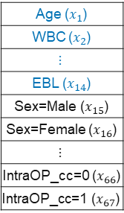



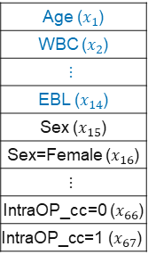









Autoencoder + MLP
Multiple MLP 적합 결과, AUC가 매우 낮게 나옴
변수간 높은 상관성이 원인일 수도 있어, 입력 레이어에 상관성을 반영할 수 있는 Autoencoder를 추가하여 모형 재적합
Model architecture
*Continuous variables are scaled using robust scaler from sklearn
Age ($x_{1}$)
WBC ($x_{2}$)
$$⋮$$
EBL ($x_{14}$)
Sex ($x_{15}$)
Sex=Female ($x_{16}$)
$$⋮$$
IntraOP_cc=0 ($x_{66}$)
$$\text{IntraOP}\text{_}\text{cc}\text{=1 (}x_{67}\text{)}$$
Age ($x_{1}$)
WBC ($x_{2}$)
$$⋮$$
EBL ($x_{14}$)
Sex=Male ($x_{15}$)
Sex=Female ($x_{16}$)
$$⋮$$
IntraOP_cc=0 ($x_{66}$)
$$\text{IntraOP}\text{_}\text{cc}\text{=1 (}x_{67}\text{)}$$
$$x_{1}$$
$${\tilde{x}}_{1}$$
1
2
$$x_{2}$$
$${\tilde{x}}_{2}$$
1
2
$$y_{1}$$
Probability that a patient experiences no complication
$$⋮$$
$$⋮$$
$$⋮$$
$$⋮$$
$$⋮$$
$$⋮$$
$$y_{2}$$
Probability that a patient experiences mild complication
1
2
$$y_{3}$$
Probability that a patient experiences severe complication or death
$$x_{66}$$
$${\tilde{x}}_{66}$$
$$i=1799$$
1
2
$$i=1$$
$$⋯$$
$$x_{67}$$
$${\tilde{x}}_{67}$$
Input layer
Hidden layers
Output layer
Train Data
Autoencoder
Multi-class MLP
Input size = 67
AE Hidden layer size = 16, 32, 64, 128
MLP Hidden layer 1 size ($m_{1}$) = 16, 32, 64
MLP Hidden layer 2 size ($m_{2}$) = 16, 32, 64

Slide 7
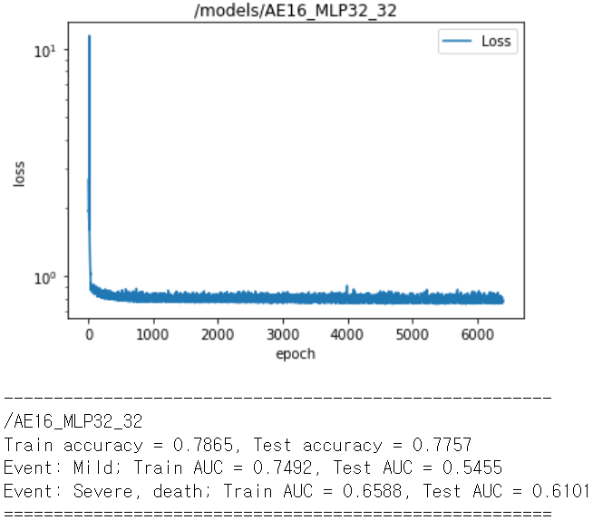
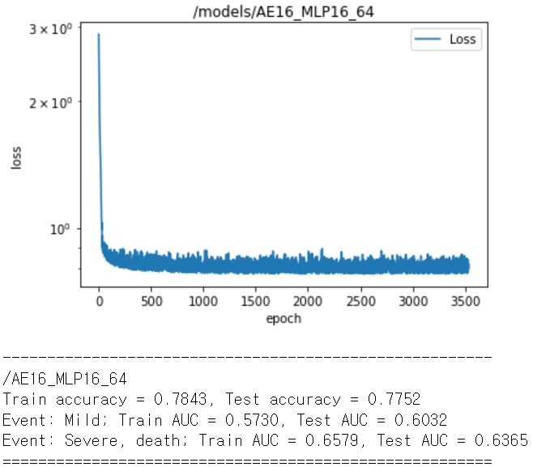
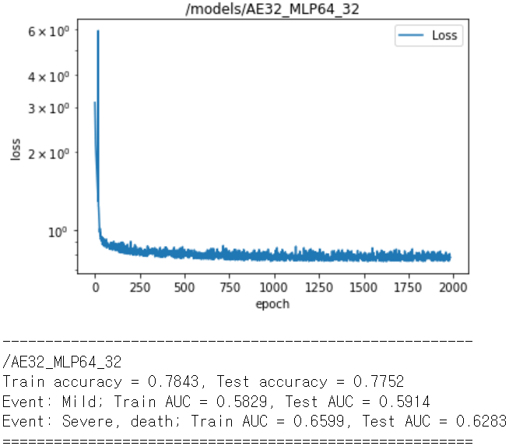

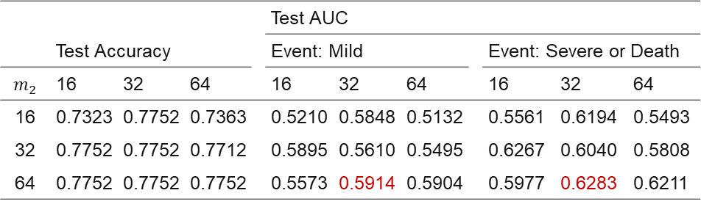

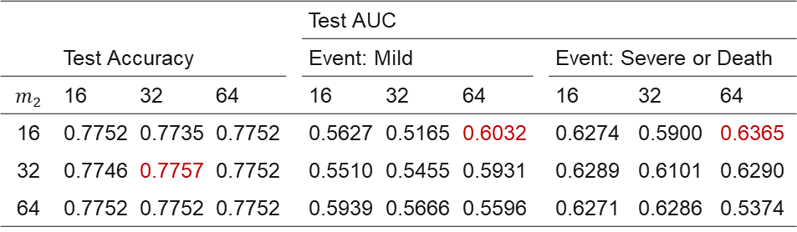
AE + Multi-class MLP 결과
② AE Hidden layer size = 32
① AE Hidden layer size = 16
 | Test Accuracy |  |  |  | Test AUC
 |  |  |  |  | Event: Mild |  |  |  | Event: Severe or Death
$$m_{2}$$ | 16 | 32 | 64 |  | 16 | 32 | 64 |  | 16 | 32 | 64
16 | 0.7752 | 0.7735 | 0.7752 |  | 0.5627 | 0.5165 | 0.6032 |  | 0.6274 | 0.5900 | 0.6365
32 | 0.7746 | 0.7757 | 0.7752 |  | 0.5510 | 0.5455 | 0.5931 |  | 0.6289 | 0.6101 | 0.6290
64 | 0.7752 | 0.7752 | 0.7752 |  | 0.5939 | 0.5666 | 0.5596 |  | 0.6271 | 0.6286 | 0.5374
 | Test Accuracy |  |  |  | Test AUC
 |  |  |  |  | Event: Mild |  |  |  | Event: Severe or Death
$$m_{2}$$ | 16 | 32 | 64 |  | 16 | 32 | 64 |  | 16 | 32 | 64
16 | 0.7323 | 0.7752 | 0.7363 |  | 0.5210 | 0.5848 | 0.5132 |  | 0.5561 | 0.6194 | 0.5493
32 | 0.7752 | 0.7752 | 0.7712 |  | 0.5895 | 0.5610 | 0.5495 |  | 0.6267 | 0.6040 | 0.5808
64 | 0.7752 | 0.7752 | 0.7752 |  | 0.5573 | 0.5914 | 0.5904 |  | 0.5977 | 0.6283 | 0.6211
$$m_{1}$$
$$m_{1}$$

Slide 8
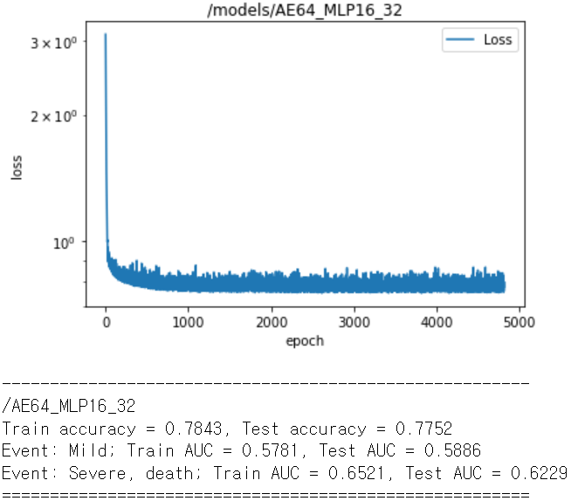
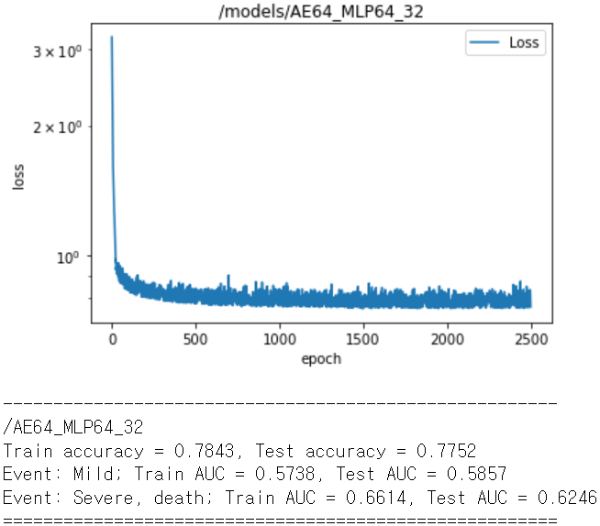

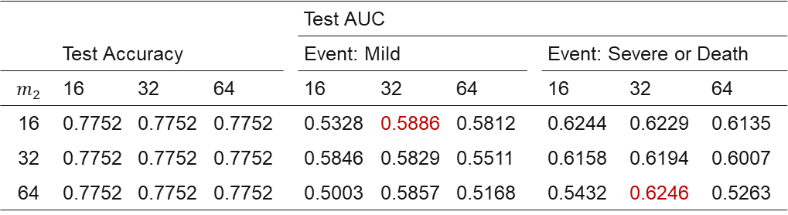
AE + Multi-class MLP 결과
③ AE Hidden layer size = 64
 | Test Accuracy |  |  |  | Test AUC
 |  |  |  |  | Event: Mild |  |  |  | Event: Severe or Death
$$m_{2}$$ | 16 | 32 | 64 |  | 16 | 32 | 64 |  | 16 | 32 | 64
16 | 0.7752 | 0.7752 | 0.7752 |  | 0.5328 | 0.5886 | 0.5812 |  | 0.6244 | 0.6229 | 0.6135
32 | 0.7752 | 0.7752 | 0.7752 |  | 0.5846 | 0.5829 | 0.5511 |  | 0.6158 | 0.6194 | 0.6007
64 | 0.7752 | 0.7752 | 0.7752 |  | 0.5003 | 0.5857 | 0.5168 |  | 0.5432 | 0.6246 | 0.5263
$$m_{1}$$

Slide 9
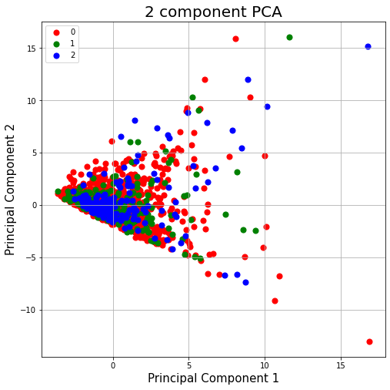
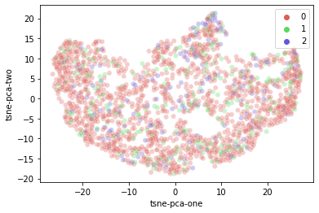




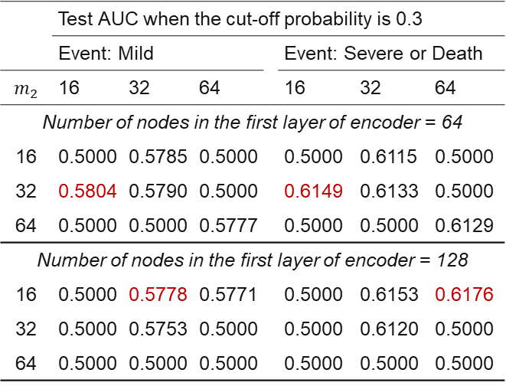




Discussion
The results are not desirable, any remedies?
Increase the number of layer of AE & change the cut-off probability from 0.5 to 0.3
AUC did not improve ☹
Evaluate the train data using principal component analysis (PCA) and t-SNE
Number of principal component = 2
Perplexity of t-SNE = 100, number of iteration = 1000
It is hard to differentiate patient group with complication from patient group without complication. Perhaps this might be the reason for classification models not working well.
$$x_{1}$$
Autoencoder
$${\tilde{x}}_{1}$$
$$x_{2}$$
$${\tilde{x}}_{2}$$
$$⋮$$
$$⋮$$
$$⋮$$
$$⋮$$
$$⋮$$
$$⋮$$
$$⋮$$
$$⋮$$
$$⋮$$
$$x_{66}$$
$${\tilde{x}}_{66}$$
$$x_{67}$$
$${\tilde{x}}_{67}$$
64 / 128
32
16
8
16
32
64/128
 | Test AUC when the cut-off probability is 0.3
 | Event: Mild |  |  |  | Event: Severe or Death
$$m_{2}$$ | 16 | 32 | 64 |  | 16 | 32 | 64
Number of nodes in the first layer of encoder = 64
16 | 0.5000 | 0.5785 | 0.5000 |  | 0.5000 | 0.6115 | 0.5000
32 | 0.5804 | 0.5790 | 0.5000 |  | 0.6149 | 0.6133 | 0.5000
64 | 0.5000 | 0.5000 | 0.5777 |  | 0.5000 | 0.5000 | 0.6129
Number of nodes in the first layer of encoder = 128
16 | 0.5000 | 0.5778 | 0.5771 |  | 0.5000 | 0.6153 | 0.6176
32 | 0.5000 | 0.5753 | 0.5000 |  | 0.5000 | 0.6120 | 0.5000
64 | 0.5000 | 0.5000 | 0.5000 |  | 0.5000 | 0.5000 | 0.5000

